Slide 1

DIGITAL PORTFOLIO
STUDENT NAME:
S.ANIS FATHIMA
24134130500122003
REGISTER NUMBER:
NMID:
490921F50AFDD1B8D0447CB25B6E5988/
asanm41341324213002
DEPARTMENT: BCA-II
COLLEGE: DEEN COLLEGE OF ARTS AND SCIENCE

Slide 2
STUDENT'S
DIGITAL
PORTFOLIO

Slide 3
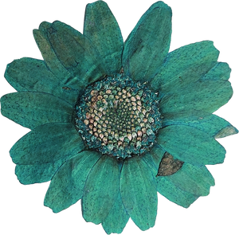
AGENDA
Problem Statement
Project overview
End Users
Tools And Technologies
Portfolio Design and Layout
Futures And Functionality
Results and Screenshots
Conclusion
GItHub Link

Slide 4
PROBLEM STATEMENT
The Traditional resume often fails to fully capture a
student's skills and project work,making it difficult for
them to stand out employers and academic institutions

Slide 5

PROJECT OVERVIEW
To Create an interactive Digital portfolio Website that allows
a Students to professionally showcase their academic
projects,technical skills and personal achievements in a
Visually appealing and Organized Manner

Slide 6
WHOE ARE THE END USERS
STUDENTS:
The Creators of the Portfolio,who want a professional to prevent their works
RECRUITERS/HIRING MANAGER:
Professionals who need to quickly asseses a candidate's
abilities and project abilities
ACADEMIC INSTITUTIONS:
Admission officers evaluating applicants for
graduation programs

Slide 7
TOOLS AND TECHNOLOGIES
HTML:
The foundational language for structuring the Portfolio
contents, including headings, Paragraphand contents
CSS:
Used for styling the Website to control its layout,
fonts,colours and responsiveness
JAVASCRIPT:
Adds interactivity such as smooth scrolling for navigation,
dynamic content loading,form validation
GIT&GITHUB:
For Version Controlling , allowing the students to manage
project code and elaborate effectively
DEPLOYMENT:
he Portfolio can be hosted for the sources like GitHub
or Netlify,making it accessible to anyone with an
internet connection

Slide 8
PORTFOLIO DESIGN AND LAYOUT
DESIGN
SIMPLE COLOUR SCHEME:
The Portfolio uses a limited colour palettes for a
professional and clean look
VISUAL HIERARCHY:
Different font sizes and weights are used to guide the
user's eye emphasize key information

Slide 9
LAYOUT
CLEAN,MINIMALIST AND RESPONSIVE:
The Overall Layout is uncluttered and adopts well
to the different screen sizes
HEADER:
The Top of the page includes the student's name,a brief
tagline and a navigation bar
DEDICATED SECTION:
The Content is organized into a separate sections,
eachwith its own clear heading like "About" and "Projects"

Slide 10
FUTURES AND FUNCTIONALITY
PROJECT SHOWCASE:
section for students to display their works including title, description,links to
the projects and it's code
SKILL HIGHLIGHTS:
A simple and updatable lists of technical skills
PROFESSIONAL AND INFORMATION:

Slide 11
FUNCTIONALITY
INTRACTIVE NAVIGATION:
The Navigation provides a smooth scrolling animation
when links are clicked, instead of an abrupt jump
RESPONSIVES:
The layout adjusts to.a different screen sizes, ensuring
a good user experience on both desktop and mobile devices

Slide 12
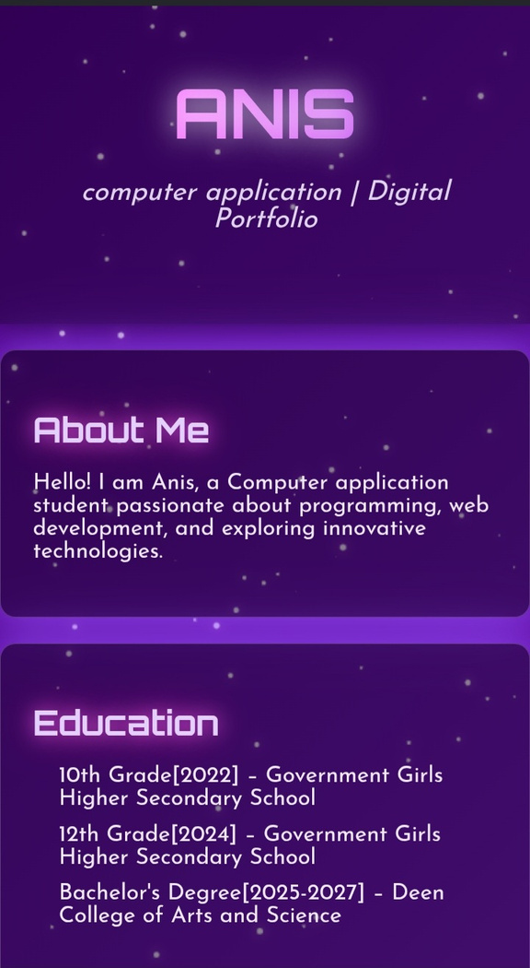
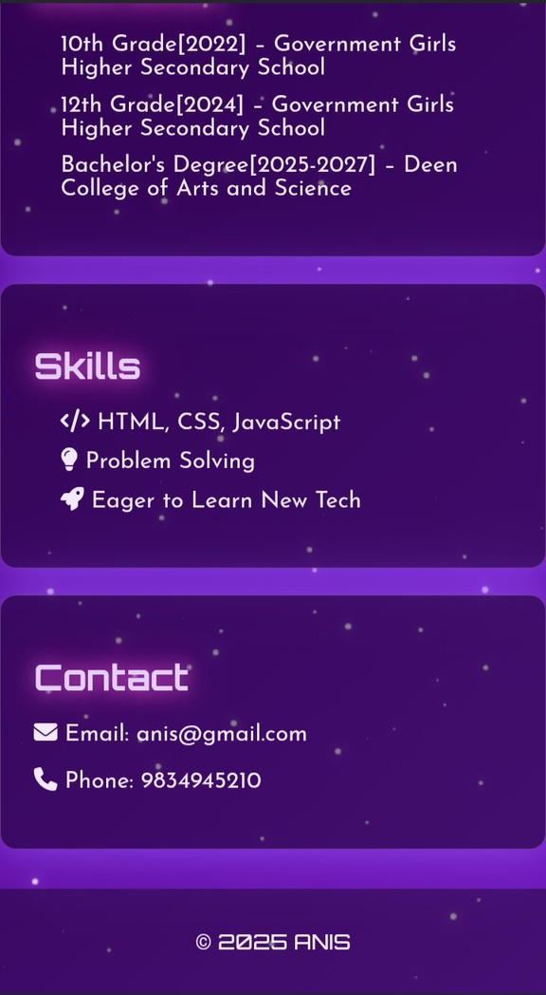
RESULTS AND SCREENSHOTS

Slide 13
CONCLUSION
HIGHLIGHT PROJECTS:
Anis's Projects, a Student management system and a code editor,show
her pratical skills in both front- end and back- end development
BENEFITS TO SOCIETY:
Her Project offers a real world benefits from improving
school administration to helping programmers work more efficiently
FINAL SUMMARY:
This portfolio effectively proves Rafitha's potential as a software developer by
showcasing her foundationalknowledge and applied project skills

Slide 14
GITHUB LINK
https://github.com/AnisFathima-1209/Anis.git

Slide 15
THANK YOU

